Slide 1
HR ANALYSIS

Slide 2
INTRODUCTION
This project revolves around analyzing a comprehensive HR dataset designed for teaching purposes by Dr. Carla Patalanoand a colleague at New England College of Business. The dataset is synthetic but reflects real-world HR challenges, providing valuable insights for data analysis and visualization. It includes various attributes such as employee names , demographic details, employment history, salaries, and performance scores. The goal is to explore HR metrics such as employee engagement, diversity, recruitment sources, and performance trends, leveraging tools like Tableau, R, and Python. This analysis will help address key HR challenges, such as predicting employee turnover, assessing diversity profiles, and identifying pay equity issues, ultimately enhancing decision-making in HR management.

Slide 3
OBJECTIVE
Analyze employee performance and identify any relationships between performance scores and managers or departments.
Assess diversity profiles within the organization and explore the effectiveness of recruitment sources in promoting diversity.
Predict employee turnover, helping the organization anticipate and mitigate attrition.
Evaluate pay equity across different departments and positions, ensuring fairness in compensation.
Visualize key HR metrics using tools like Tableau, enabling HR professionals to understand trends and areas for improvement.

Slide 4
MAIN KPIs
1. Employee Performance Score
2. Employee Engagement Score
3. Employee Satisfaction Score
4. Absenteeism Rate
5. Employee Turnover Rate
6. Recruitment Source Effectiveness
7. Diversity Index
8. Pay Equity Analysis
9. Days Late in Last 30 Days
10. Tenure Distribution
11. Reasons for Termination
12. Department-wise Attrition Rate

Slide 5
TABLEAU
The HR dataset developed by Dr. Carla Patalano serves as an essential learning tool for human resources professionals to build their data visualization and analytics skills. Tableau Desktop is an ideal platform to analyze this dataset due to its intuitive interface and powerful visualization capabilities.

Slide 6
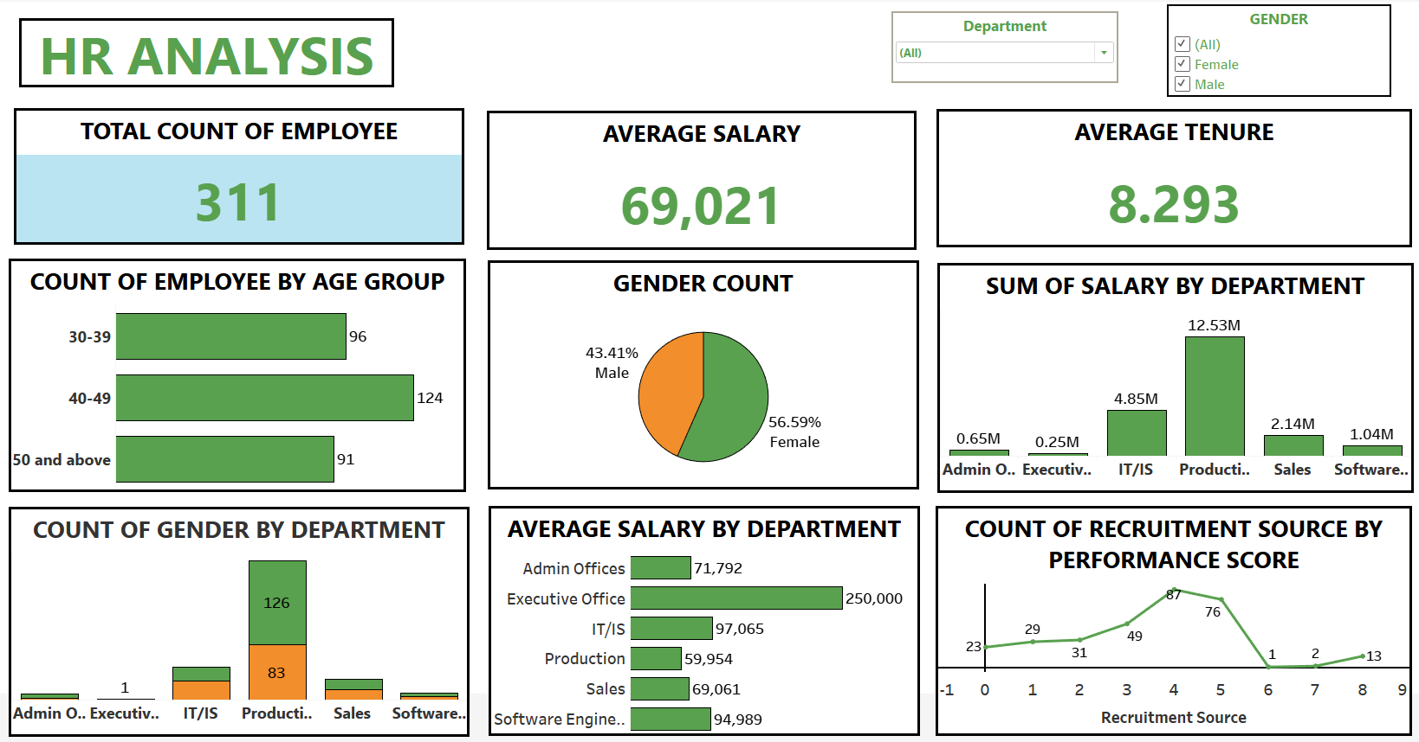

Slide 7
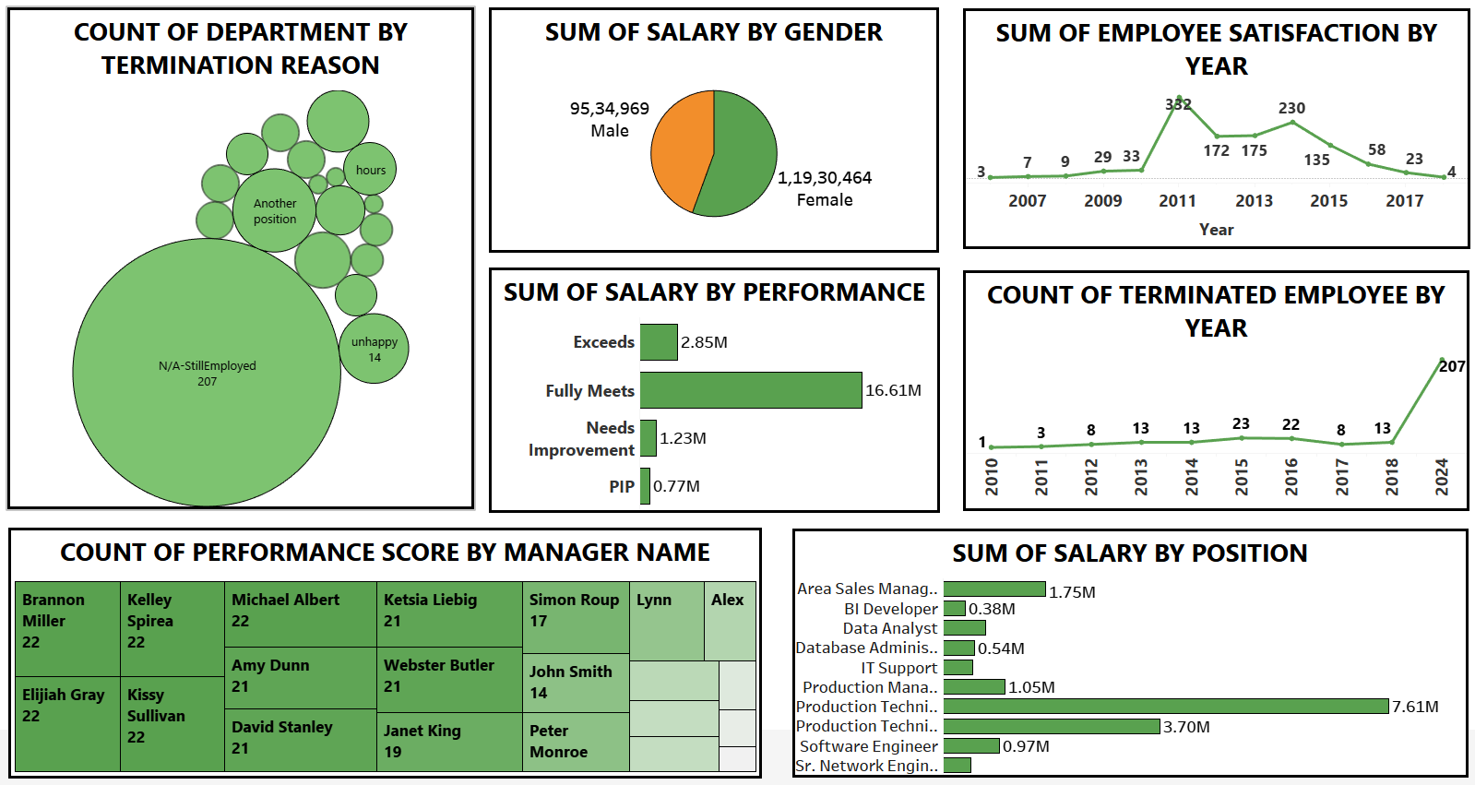

Slide 8
PYTHON
Python is an excellent tool for analyzing the HR dataset created by Dr. Carla Patalano due to its versatility and powerful libraries for data analysis and visualization. By leveraging Python, HR professionals and data analysts can explore the dataset programmatically, conduct in-depth analysis, and uncover meaningful insights to support data-driven decisions.

Slide 9
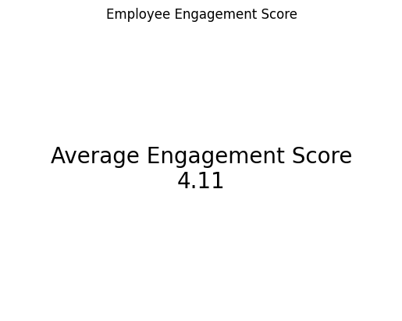
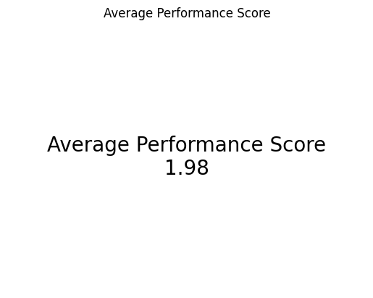
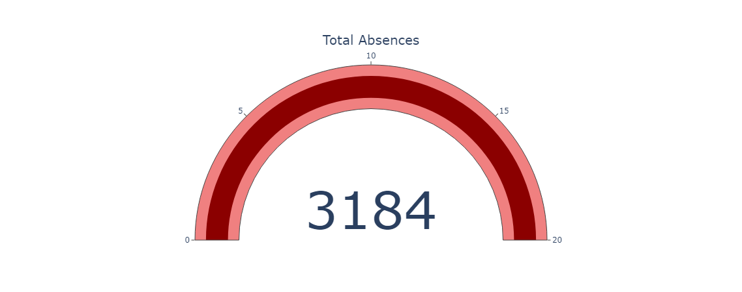
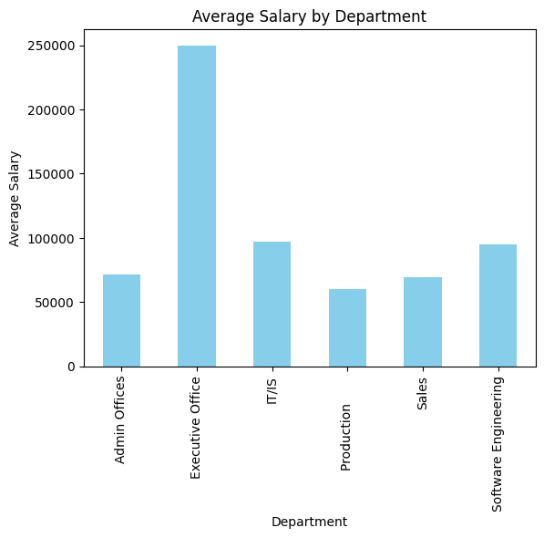

Slide 10
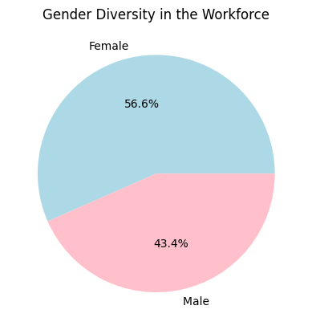
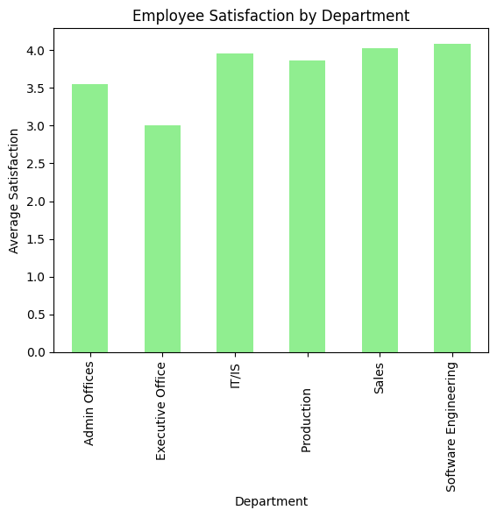
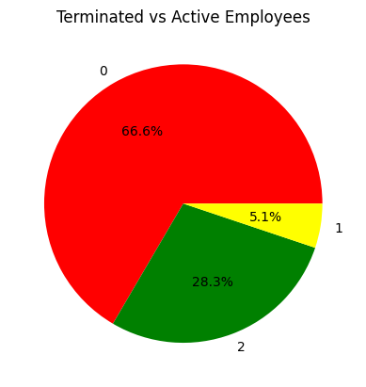
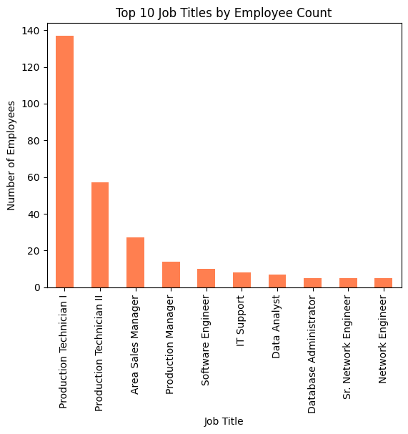

Slide 11
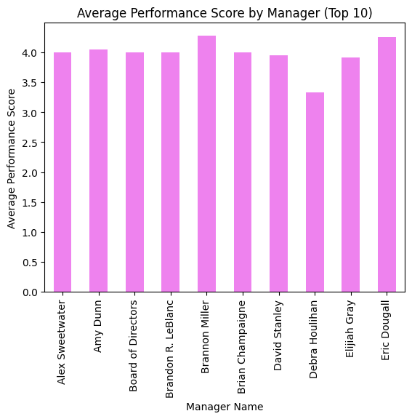
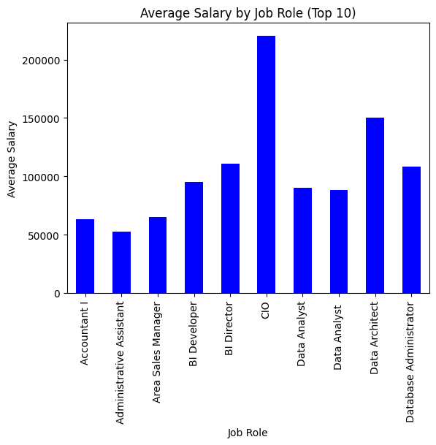
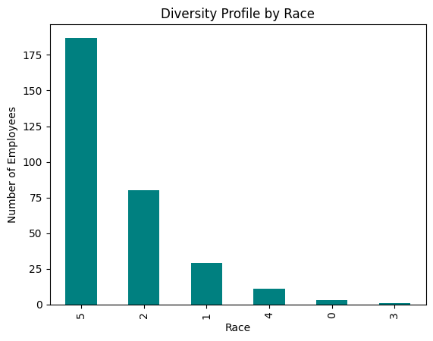
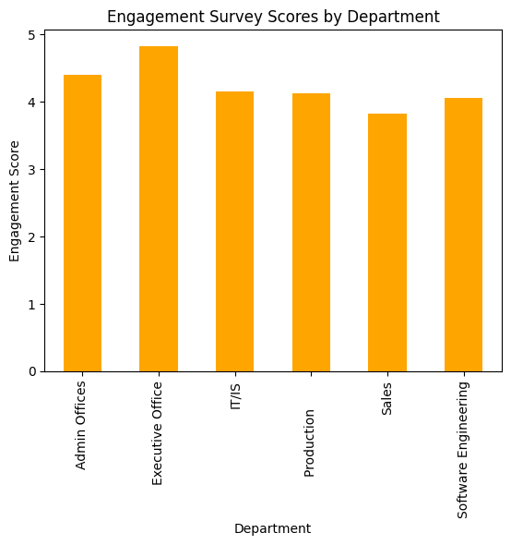

Slide 12
CONCLUSION
The HR dataset created by Dr. Carla Patalano and her colleague provides a valuable tool for teaching HR professionals how to leverage data for strategic decision-making. By using Tableau, Python, or R for visualizations and analysis, key insights into employee performance, diversity, pay equity, and turnover can be uncovered. These insights enable organizations to enhance recruitment strategies, address pay gaps, boost employee engagement, and predict potential attrition. As more data is added and refined, the dataset will continue to serve as a practical resource for HR analytics education.

Slide 13


VISIT FOR DETAILED PROJECT
Click on linkedin logo to visit my Profile
Click on Github logo to visit the portfolio of the project

